Slide 1
Mobile Development with Flutter
Introduction to Flutter and what makes it a valid option to develop mobile apps in 2020.

Slide 2



Luca
Salsabil
Your hosts tonight

Slide 3

Agenda
Intro to mobile development
Native vs cross-platform
Introduction to Flutter
Quiz & Demo
Dart in a nutshell
Quiz & Demo
Closing remarks
Q&A
Goodbye

Slide 4
Smartphones
Facts
Notes:
Who has a smartphone?
Vs
Who has a dumbphone?
Business cards vs Linkedin profile

Slide 5
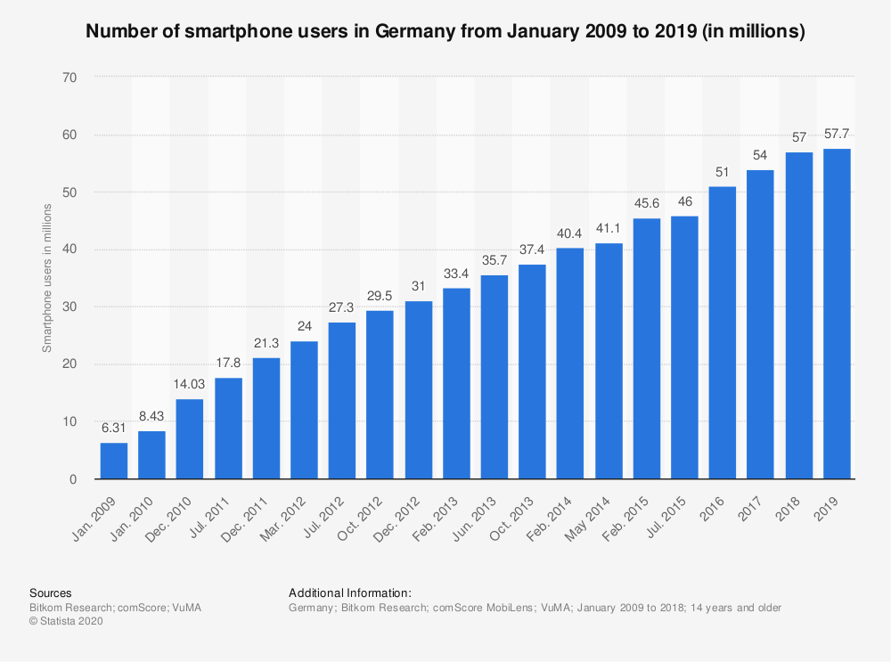


Number of mobile app downloads worldwide in 2019 204bn
Number of mobile app downloads worldwide in 2016 140.7bn
Why should we care about mobile development?
Source: statista.com

Slide 6
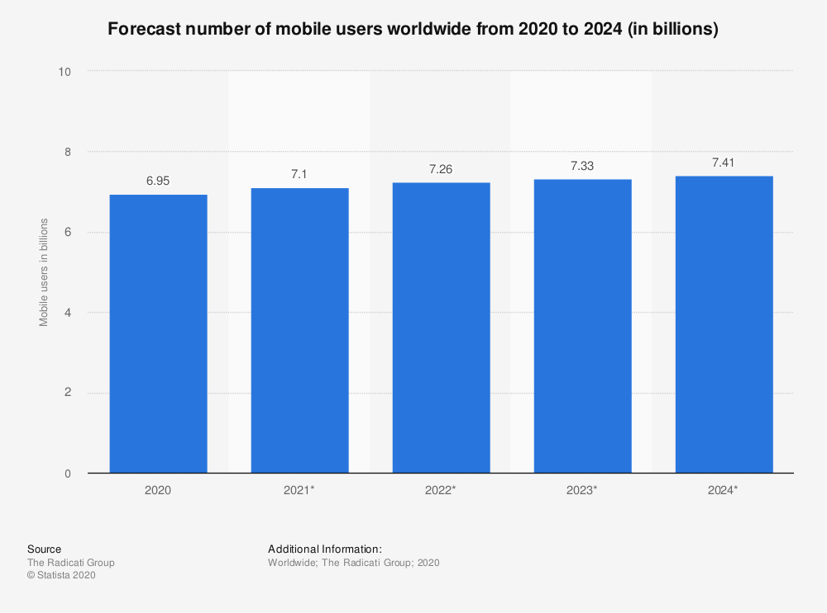
Number of mobile app downloads worldwide in 2019 204bn
Number of mobile app downloads worldwide in 2016 140.7bn
Why should we care about mobile development?
Source: statista.com

Slide 7
Businesses need apps, good ones.
Notes:
Nobody has time for bad user experiences, your customers and employees included.

Slide 8
What do we have at our disposal?

Slide 9
Native - Cross Platform
A native app is built using the programming language and tools for the specific device platform.
A cross-platform app is built with non-native tools and it has historically made use of web technologies to render WebViews
Notes:
Developing, maintaining and releasing with native approach is also more complex for coordination and strategy
E.g.
how do you coordinate for a new feature?
When should you release? When first platform is ready or at the same time?

Slide 10


Native - Hybrid - Cross Platform
Swift
Objective-C
Kotlin
Java

Slide 11

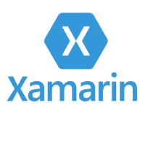




Native - Hybrid - Cross Platform

Slide 12
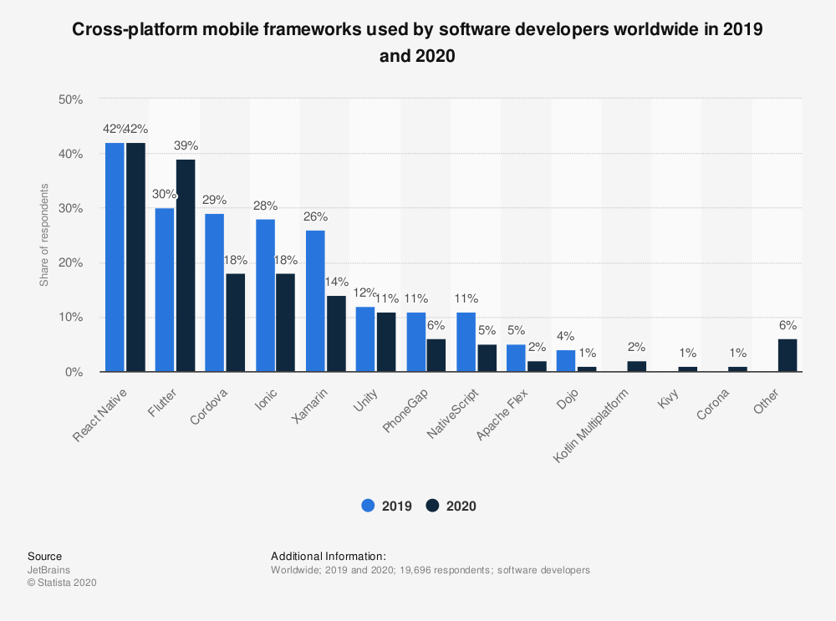
Cross platform frameworks - distribution

Slide 13
Flutter is the definitely promising!

Slide 14
What is Flutter?

Slide 15
Flutter - intro
Free and Open Source UI toolkit
Provides a SDK to develop apps for Android and iOS
Good for developers, designers
Notes:
UI toolkit developed and open sourced by google
Will Larche → talks about how flutter is good for designers

Slide 16
Flutter - something more
Full control over the rendering stack
Reactive views with no bridge
Great development experience
Fast, smooth and predictable UI
Deploy on multiple platforms with one codebase
Great community
Notes:
Flutter needs a blank canvas and it will simply draw on it.

Slide 17
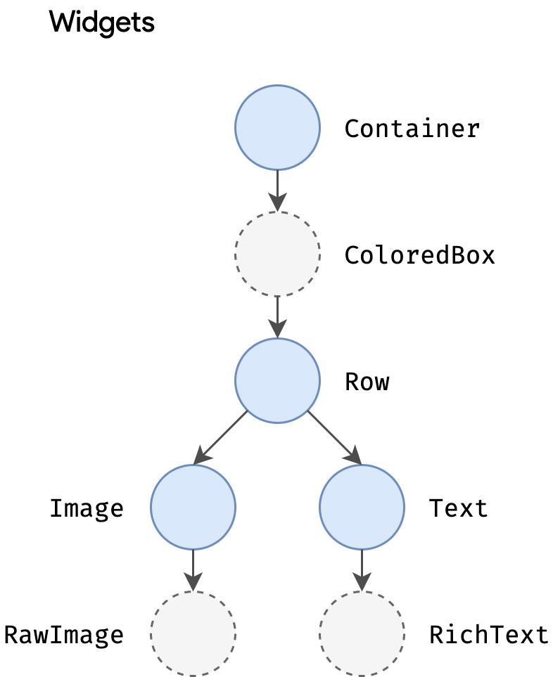
Flutter - widgets
In Flutter, everything is a widget!
UI elements (Text, Image, etc.)
Layout constraints (Padding, Column, Alignment, etc.)
You can compose widgets to create your UI
Flutter offers a rich set of default widgets (here)
Source: flutter doc
Notes:
Flutter needs a blank canvas and it will simply draw on it.

Slide 18
Demo!
Notes:
Show skeleton project,
Hot reload (change icon, column axis settings)
Change theme and talk about theming
Demonstrate that everything is a widget
Use transform.rotate on Text
Use transform.rotate on MaterialApp
Random image at: https://source.unsplash.com/random

Slide 19
Dart in a nutshell

Slide 20

Dart - intro
Flutter code is written in Dart
Dart is a client-optimized language for fast apps on any platform
Can be both JIT compiled and AOT compiled
Type safe: it uses a combination of static type checking and runtime checks
Source: flutter doc
Notes:
Why Flutter uses Dart: https://hackernoon.com/why-flutter-uses-dart-dd635a054ebf (advanced)

Slide 21
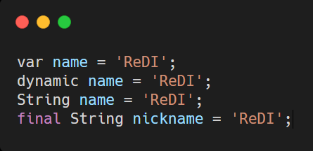
Dart - a bit more
Typing system (primitive types, var vs dynamic)
Source: flutter doc
Notes:
Typing system (primitive types, var vs dynamic)
Example: Map<String, dynamic> response = {
'content-type': 'application/json',
'length': 204
};
Functions (how to declare, etc)
async/await
Future/Streams
https://dart.dev/

Slide 22
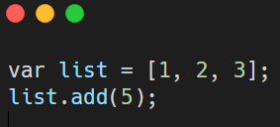
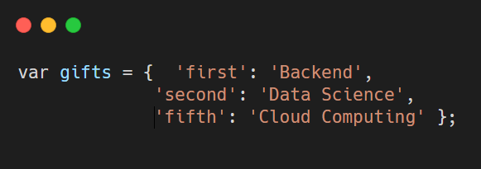
Dart - types
The Dart language has also support for the following types:
Lists
Maps
Notes:
Types
numbers
strings
booleans
lists (also known as arrays)
sets
maps
runes (for expressing Unicode characters in a string)
symbols

Slide 23
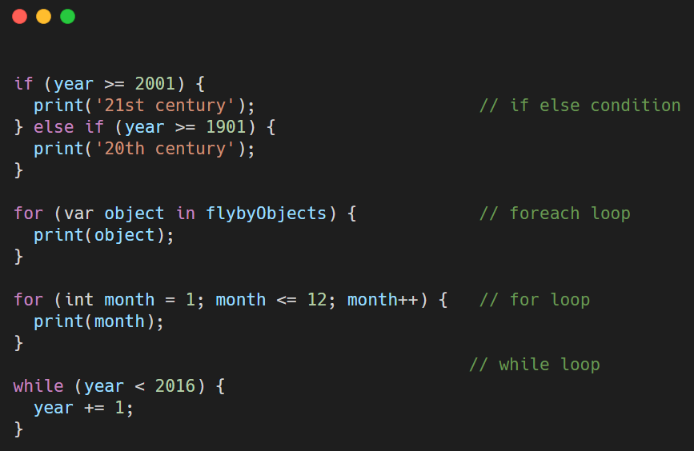
Control flow statements

Slide 24
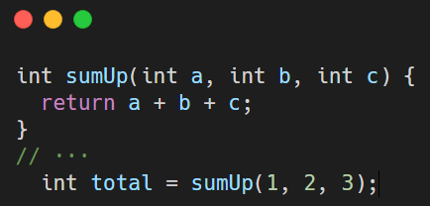
Functions
Define a simple addition function:

Slide 25
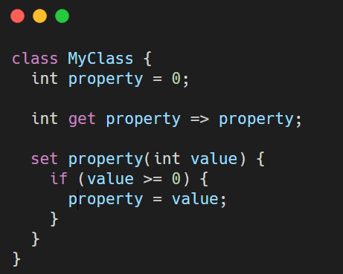
Class

Slide 26
Awaits / Async / Future
Synchronous operation:
A synchronous operation blocks other operations from executing until it completes.
Asynchronous operation:
Once initiated, an asynchronous operation allows other operations to execute before it completes.

Slide 27
Awaits / Async / Future
The async and await keywords provide a declarative way to define asynchronous functions and use their results.
A future represents the result of an asynchronous operation, and can have three states:
Uncompleted,
Completed with a value,
Completed with an error.

Slide 28
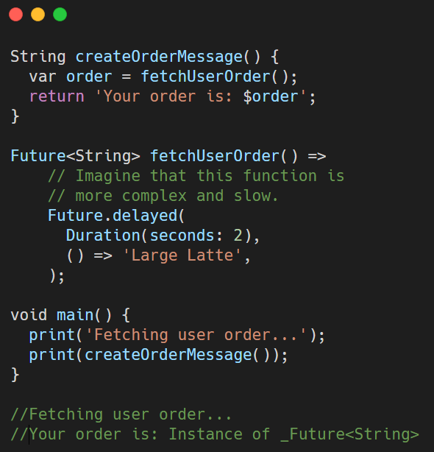
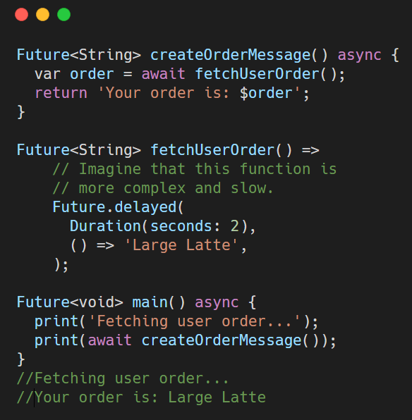
Synchronous vs Asynchronous

Slide 29
Demo!
Notes:
Show skeleton project,
Hot reload (change icon, column axis settings)
Change theme and talk about theming
Demonstrate that everything is a widget
Use transform.rotate on Text
Use transform.rotate on MaterialApp
Random image at: https://source.unsplash.com/random

Slide 30
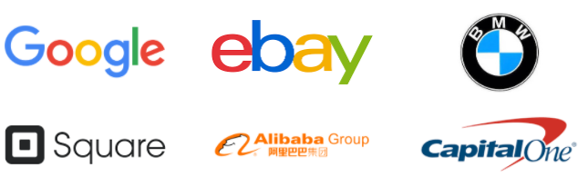
Who’s using Flutter?
...And many more!
You can see more here.
Source: flutter doc

Slide 31
Questions?

Slide 32
THANK YOU!

